Slide 1
Chapter 17
Reliability Analysis

Slide 2
Learning Objectives
Explain the concept of reliability and validity
Describe the various types of reliability—internal consistency reliability, test–rest and alternative form
Describe the assumptions for measuring reliability
Demonstrate the steps used in SPSS to execute Cronbach’s alpha and split-half reliability analysis
Explain how to analyse and interpret the SPSS outputs for Cronbach’s alpha and split-half reliability
Report the final results of reliability analysis

Slide 3
Introduction
The reliability measurement is most commonly used in questionnaire development process.
The reliability ensures the consistent results from the questionnaire over a period of time.
It also confirms the same results of the questionnaire from same respondents at different points of time.
The reliability also ensures the same results from different respondents at one particular point of time.

Slide 4
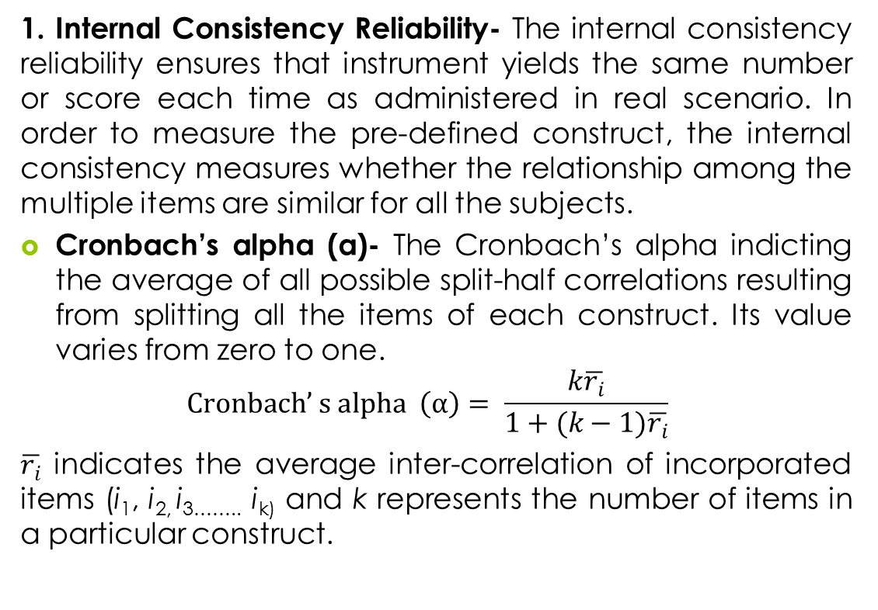
Types of Reliability

Slide 5
2. Split-half reliability: All the items of a particular construct are divided into two halves or equivalent groups. The splitting technique is employed by the software either randomly or by odd and even items. The correlation coefficient for all the items in two halves is computed by SPSS.
3. Test–retest reliability: The same set of questionnaire is administered to the same subjects at two different time slots in order to examine the retest reliability.

Slide 6
Table 17.1. Test–Retest Reliability
 | Score Measured
Students | Test-1 (at T1 time) | Test-2 (at T2 time)
1 | 58 | 54
2 | 67 | 63
3 | 43 | 39
4 | 89 | 84
5 | 76 | 78

Slide 7
4. Alternative forms of reliability: Two different forms of questionnaires are administered among the subjects to examine the same constructs over a period of time.
Table 17.2. Alternative Forms of Reliability
 | Score Measured
Students | Type-A (at T1 time) | Type-B (at T2 time)
1 | 48 | 50
2 | 77 | 74
3 | 33 | 36
4 | 79 | 81
5 | 86 | 83

Slide 8
Research Problem
Computing the reliability analysis for the construct ‘happiness’ based on the internal consistency analysis.
In order to operationalize this construct for the present scenario, 10 items are identified as degree to which the individual judges the overall quality of his/her life in a positive way.

Slide 9
Table 17.3. Statements of Construct: Happiness
Sr. No. | Items* | Rating (1 = strongly disagree to 7 = strongly agree)
I-1 | In general, I consider myself a very happy person. | 1 | -- | -- | -- | -- | -- | 7
I-2 | As compared with my peers, I consider myself happier. | 1 | -- | -- | -- | -- | -- | 7
I-3 | I enjoy my life, regardless of what is going on. | 1 | -- | -- | -- | -- | -- | 7
I-4 | I always try to get most out from everything in my life. | 1 | -- | -- | -- | -- | -- | 7
I-5 | I am very happy with my self-image. | 1 | -- | -- | -- | -- | -- | 7
I-6 | I always express my gratitude to God for being happy and satisfied. | 1 | -- | -- | -- | -- | -- | 7
I-7 | I do not feel particularly pleased with the way I am. | 1 | -- | -- | -- | -- | -- | 7
I-8 | I strongly believe that life is good. | 1 | -- | -- | -- | -- | -- | 7
I-9 | I often experience joy and elation. | 1 | -- | -- | -- | -- | -- | 7
I-10 | I do not have fun with other people. | 1 | -- | -- | -- | -- | -- | 7

Slide 10
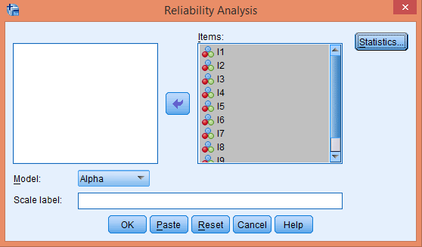
Executing Reliability Analysis with SPSS
Selection of Method for Reliability
Exhibit 17.1. Use reliability.sav » Menu bar » analyse » Scale » Reliability Analysis » Select all items (I-1 to I-10) and transfer to Items box » Click on Statistics

Slide 11
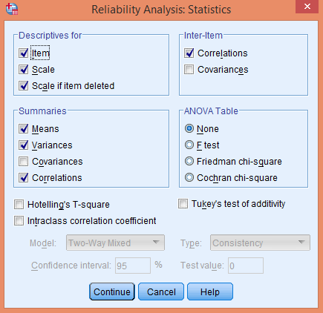
SPSS Path for Computing Descriptive Statistics, Inter-item Correlation and Summary
Exhibit 17.2. Click Statistics option » Select Item, Scale, and Scale if item deleted in area Descriptive for » Select Correlations in Inter-item » Scale Means and Variances in Summaries » Continue » Click OK

Slide 12
Interpreting the Outputs of Reliability Analysis
Cronbach's Alpha
Table 17.4a. Cronbach's Alpha
Cronbach's Alpha | Cronbach's Alpha Based on Standardized Items | N of Items
0.651 | 0.662 | 10
The value 0.651 (Cronbach's Alpha) is a questionable value (less than 0.7). Hence, we need to notice other associated outputs to improve or rectify this value.

Slide 13
Individual Item Statistics
Table 17.4b. Individual Item Statistics
Item Statistics |  |  |  |  | Item Statistics
Item | Mean | Std. Deviation | N | Item | Mean | Std. Deviation | N
I-1 | 4.70 | 1.70 | 30 | I-6 | 4.90 | 1.95 | 30
I-2 | 4.06 | 1.74 | 30 | I-7 | 3.20 | 1.82 | 30
I-3 | 4.36 | 1.75 | 30 | I-8 | 4.56 | 1.59 | 30
I-4 | 4.36 | 1.90 | 30 | I-9 | 2.96 | 1.54 | 30
I-5 | 4.66 | 1.66 | 30 | I-10 | 3.03 | 2.14 | 30
Lowest mean rating occurs for I-9 followed by I-10 and I-7, whereas the rest of the items reveal almost equal mean scores.

Slide 14
Inter-item Correlation Matrix
Table 17.4c Inter-item Correlation Matrix
 | I-1 | I-2 | I-3 | I-4 | I-5 | I-6 | I-7 | I-8 | I-9 | I-10
I-1 | 1.000 | 0.472 | 0.581 | 0.088 | 0.340 | 0.177 | −0.412 | 0.154 | 0.062 | 0.060
I-2 | 0.472 | 1.000 | 0.512 | 0.034 | 0.341 | 0.367 | −0.189 | 0.285 | 0.104 | 0.249
I-3 | 0.581 | 0.512 | 1.000 | 0.134 | 0.291 | 0.203 | −0.142 | 0.406 | 0.005 | −0.013
I-4 | 0.088 | 0.034 | 0.134 | 1.000 | 0.333 | 0.047 | 0.008 | 0.430 | 0.298 | 0.039
I-5 | 0.340 | 0.341 | 0.291 | 0.333 | 1.000 | 0.265 | −0.272 | 0.360 | 0.049 | 0.138
I-6 | 0.177 | 0.367 | 0.203 | 0.047 | 0.265 | 1.000 | −0.071 | 0.407 | 0.228 | 0.388
I-7 | −0.412 | −0.189 | −0.142 | 0.008 | −0.272 | −0.071 | 1.000 | −0.100 | 0.382 | −0.099
I-8 | 0.154 | 0.285 | 0.406 | 0.430 | 0.360 | 0.407 | −0.100 | 1.000 | 0.078 | 0.258
I-9 | 0.062 | 0.104 | 0.005 | 0.298 | 0.049 | 0.228 | 0.382 | 0.078 | 1.000 | 0.084
I-10 | 0.060 | 0.249 | −0.013 | 0.039 | 0.138 | 0.388 | −0.099 | 0.258 | 0.084 | 1.000

Slide 15
The value of inter-item correlation matrix should lie between 0.15 and 0.85. It can be seen that I-7 is negatively associated with majority of the items, hence not fit with the construct happiness.

Slide 16
Summary Item Statistics
Table 17.4d. Summary Item Statistics
 | Mean | Minimum | Maximum | Range | Max/Min | Variance | N of Items
Item means | 4.08 | 2.96 | 4.90 | 1.93 | 1.65 | 0.546 | 10
Item variances | 3.20 | 2.37 | 4.58 | 2.20 | 1.92 | 0.43 | 10
Inter-item correlations | 0.164 | −0.41 | 0.58 | 0.99 | −1.41 | 0.04 | 10
The mean of 10 variances is 3.2 consisting of 2.3 and 4.5 as minimum and maximum mean variances, respectively.

Slide 17
Item Total Statistics
Table 17.4e. Item Total Statistics
 | Scale Mean if Item Deleted | Scale Variance if Item Deleted | Corrected Item-Total Correlation | Squared Multiple Correlation | Cronbach's Alpha if Item Deleted
I-1 | 36.13 | 65.56 | 0.325 | 0.531 | 0.625
I-2 | 36.76 | 61.01 | 0.493 | 0.416 | 0.590
I-3 | 36.46 | 62.53 | 0.428 | 0.535 | 0.604
I-4 | 36.46 | 64.94 | 0.290 | 0.359 | 0.632
I-5 | 36.16 | 63.73 | 0.411 | 0.306 | 0.608
I-6 | 35.93 | 59.85 | 0.456 | 0.360 | 0.594
I-7 | 37.63 | 80.10 | −0.183 | 0.397 | 0.722
I-8 | 36.26 | 61.65 | 0.531 | 0.468 | 0.586
I-9 | 37.86 | 67.70 | 0.290 | 0.357 | 0.632
I-10 | 37.80 | 64.57 | 0.241 | 0.221 | 0.646

Slide 18
The value of Cronbach's Alpha would be 0.625. Similarly, if I-2 is deleted, its value would become lower as 0.59. Its value would increase to 0.722 in case I-7 is deleted. Hence, it exceeds the initial level (0.651) of reliability.
Overall Scale Statistics
Table 17.4f. Scale Statistics
Mean | Variance | Std. Deviation | N of Items
40.83 | 77.45 | 8.80 | 10

Slide 19
Reproduced Alpha
Table 17.5. New Score of Reliability
Cronbach's Alpha | N of Items
0.722 | 9
Table 17.6. Item-Total Statistics
 | Scale Mean if Item Deleted | Scale Variance if Item Deleted | Corrected Item-Total Correlation | Cronbach's Alpha if Item Deleted
I-1 | 32.93 | 65.65 | 0.418 | 0.694
I-2 | 33.56 | 62.46 | 0.531 | 0.673
I-3 | 33.26 | 64.27 | 0.454 | 0.687
I-4 | 33.26 | 67.65 | 0.282 | 0.719
I-5 | 32.96 | 64.72 | 0.469 | 0.685
I-6 | 32.73 | 61.99 | 0.464 | 0.684
I-8 | 33.06 | 63.72 | 0.546 | 0.673
I-9 | 34.66 | 72.50 | 0.199 | 0.728
I-10 | 34.60 | 66.45 | 0.260 | 0.728

Slide 20
Split-Half Reliability
The items of a particular construct are divided into two halves either even or odd questions (statements) and then compared the results to measure the reliability.
Executing Split-Half Reliability with SPSS
The data set split-half.sav is used to examine the split-half reliability for the same construct happiness. In order to compute the same, we divide the items into two halves (I-1 to I-5 and I-6 to I-10). In first half, all the items (I-1 to I-5) are positively framed, whereas second half consists of (I-6, to I-10) the negative items.

Slide 21
Table 17.7. Statements for Split-Half Reliability
Sr. No. | Items | Rating (1= strongly disagree to 7 = strongly agree)
I-1 | In general, I consider myself a very happy person. | 1 | -- | -- | -- | -- | -- | 7
I-2 | As compared with my peers, I consider myself happier. | 1 | -- | -- | -- | -- | -- | 7
I-3 | I enjoy my life, regardless of what is going on. | 1 | -- | -- | -- | -- | -- | 7
I-4 | I always try to get most out from everything in my life. | 1 | -- | -- | -- | -- | -- | 7
I-5 | I am very happy with my self-image. | 1 | -- | -- | -- | -- | -- | 7
I-6 | I do not always express my gratitude to God for being happy and satisfied. | 1 | -- | -- | -- | -- | -- | 7
I-7 | I do not feel particularly pleased with the way I am. | 1 | -- | -- | -- | -- | -- | 7
I-8 | I strongly believe that life is not so good. | 1 | -- | -- | -- | -- | -- | 7
I-9 | I least experience joy and elation. | 1 | -- | -- | -- | -- | -- | 7
I-10 | I do not have fun with other people. | 1 | -- | -- | -- | -- | -- | 7

Slide 22
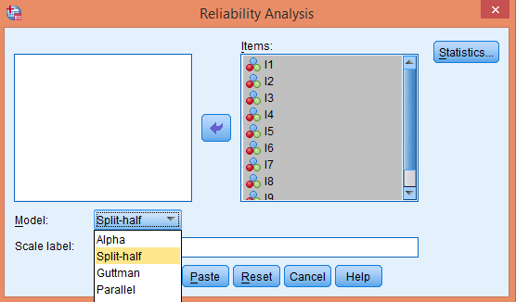
Selection of Method for Reliability
Exhibit 17.3. Use Split-half.sav » menu bar » analyse » scale » reliability analysis » select all items (I-1 to I-10) and transfer to items box » select method split-half click on statistics

Slide 23
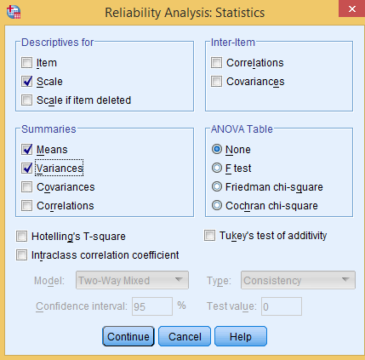
SPSS Path for Computing Cronbach’s Alpha for Two Parts and Correlation Coefficients
Exhibit 17.4. Click statistics option » select scale in the area Descriptive for » Select Means and Variance in the Summaries option continue » click on Ok

Slide 24
Interpreting the Outputs of Split-Half Reliability Analysis
Reliability Statistics
Table 17.8a. Reliability Statistics: Split-Half
Cronbach’s alpha | Part 1 | Value | 0.855
 |  | N of items | 5ª
 | Part 2 | Value | 0.856
 |  | N of items | 5^{b}
 | Total N of items |  | 10
Correlation between forms |  |  | 0.605
Spearman–Brown Coefficient | Equal Length |  | 0.754
 | Unequal Length |  | 0.754
Guttman split-half coefficient |  |  | 0.751
ªThe items are: I1, I2, I3, I4, I5.
^{b}The items are: I6, I7, I8, I9, I10.

Slide 25
In both parts, the number of items is the same (five in each) and the value of Cronbach’s alpha is also good and more than 0.8 (α > 0.8). The correlation between the forms is moderately positive (r = 0.605).

Slide 26
Table for Split-Half Reliability
Table 17.8b. Calculation for Split-Half Reliability
 | Part-1 |  |  |  |  | Part-2 |  |  |  |  | Sum P1 | Sum P2
Subjects | I-1 | I-2 | I-3 | I-4 | I-5 | I-6 | I-7 | I-8 | I-9 | I-10
1 | 5 | 4 | 6 | 4 | 5 | 2 | 2 | 7 | 1 | 3 | 24 | 15
2 | 4 | 5 | 4 | 5 | 6 | 1 | 1 | 2 | 3 | 2 | 24 | 9
3 | 4 | 4 | 6 | 1 | 2 | 5 | 2 | 2 | 7 | 1 | 17 | 17
4 | 6 | 2 | 2 | 1 | 2 | 1 | 6 | 7 | 5 | 2 | 13 | 21
5 | 5 | 6 | 6 | 4 | 6 | 5 | 6 | 7 | 2 | 3 | 27 | 23
6 | 6 | 5 | 5 | 6 | 4 | 5 | 6 | 7 | 6 | 6 | 26 | 30
7 | 7 | 5 | 6 | 7 | 6 | 6 | 7 | 3 | 5 | 5 | 31 | 26
8 | 4 | 4 | 6 | 3 | 3 | 4 | 2 | 2 | 2 | 1 | 20 | 11
9 | 3 | 5 | 2 | 1 | 2 | 1 | 3 | 1 | 2 | 2 | 13 | 9
10 | 2 | 2 | 4 | 3 | 4 | 2 | 1 | 4 | 2 | 1 | 15 | 10
Subjects 11 to 20 are omitted
21 | 2 | 2 | 2 | 2 | 3 | 3 | 1 | 1 | 2 | 3 | 11 | 10
22 | 2 | 4 | 3 | 3 | 3 | 2 | 1 | 4 | 2 | 2 | 15 | 11
23 | 3 | 1 | 3 | 2 | 2 | 1 | 2 | 1 | 1 | 2 | 11 | 7
24 | 7 | 7 | 4 | 6 | 7 | 2 | 2 | 1 | 2 | 2 | 31 | 9
25 | 1 | 2 | 2 | 1 | 2 | 3 | 1 | 4 | 3 | 1 | 8 | 12
26 | 5 | 1 | 3 | 3 | 3 | 1 | 2 | 1 | 2 | 1 | 15 | 7
27 | 4 | 6 | 5 | 4 | 5 | 2 | 2 | 1 | 1 | 2 | 24 | 8
28 | 5 | 5 | 4 | 6 | 6 | 2 | 1 | 2 | 1 | 1 | 26 | 7
29 | 1 | 4 | 3 | 1 | 2 | 1 | 2 | 1 | 2 | 1 | 11 | 7
30 | 5 | 2 | 5 | 4 | 7 | 5 | 6 | 5 | 1 | 2 | 23 | 19
 | Correlation coefficient between scores P1 and P2 |  |  |  |  |  |  |  |  |  | 0.605
 | Standard deviation of score P1 (σ₁) |  |  |  |  |  |  |  |  |  | 7.32
 | Standard Deviation of score P1 (σ₂) |  |  |  |  |  |  |  |  |  | 8.10

Slide 27
Summary Item Statistics
Table 17.8c. Summary Item Statistics
 |  | Mean | Minimum | Maximum | Range | Max/Min | Variance | N of Items
Item means | Part 1 | 4.08 | 3.70 | 4.46 | 0.76 | 1.20 | 0.08 | 5ª
 | Part 2 | 3.14 | 2.73 | 3.53 | 0.80 | 1.29 | 0.09 | 5^{b}
 | Both parts | 3.61 | 2.73 | 4.46 | 1.73 | 1.63 | 0.32 | 10
Item variances | Part 1 | 3.38 | 2.25 | 4.21 | 1.96 | 1.86 | 0.68 | 5ª
 | Part 2 | 4.14 | 3.30 | 4.74 | 1.43 | 1.43 | 0.35 | 5^{b}
 | Both parts | 3.76 | 2.25 | 4.74 | 2.48 | 2.10 | 0.61 | 10
Overall Scale Statistics
Table 17.8d. Scale Statistics
 | Mean | Variance | Std. Deviation | N of Items
Part 1 | 20.40 | 53.62 | 7.32 | 5ª
Part 2 | 15.70 | 65.66 | 8.10 | 5^{b}
Both parts | 36.10 | 191.05 | 13.82 | 10

Slide 28
Reporting the Final Results of Split-Half Reliability
The value of Cronbach’s alpha is greater than 0.8 (α = 0.85) for both parts 1 and 2, hence internal consistency for both negative and positive items is verified.
The correlation coefficient between part 1 and part 2 are also strong positive (r = 0.605), hence we can say that the results obtained from both the parts are also consistent.
The internal consistency is also determined by split-half method for the construct happiness. The measure of Spearman–Brown coefficient is more than 0.6, hence the items as adapted to measure the construct happiness are reliable and the scale can be used for further analysis.

Slide 29
Key Terms
Alternative forms Construct Corrected Item-Total Correlation Cronbach’s alpha Cronbach's Alpha if Item Deleted Guttman Split-Half Coefficient Inter-Item Correlation Matrix Internal consistency Items | Item-Total Statistics Reliability Scale Mean if Item Deleted Scale Variance if Item Deleted Spearman-Brown Coefficient Split-Half Reliability Squared Multiple Correlation Summary Item Statistics Test-rest

